Slide 1
Database Governance (Security at the DBMS storage level)
Cryptography

Slide 2
Cryptography
Basics
Cryptography is the science of secret, or hidden writing
It has two main Components:
  Encryption
    Practice of hiding messages so that they can not be read by anyone other than the intended recipient
  Authentication & Integrity
    Ensuring that users of data/resources are the persons they claim to be and that a message has not been altered

Slide 3


Encryption
Cipher
Cipher is a method for encrypting messages
Encryption algorithms are standardized & published
The key which is an input to the algorithm is secret
  Key is a string of numbers or characters
  If same key is used for encryption & decryption the algorithm is called symmetric
  If different keys are used for encryption & decryption the algorithm is called asymmetric
Plain Text
Encryption
Algorithm
Cipher Text
Decryption
Algorithm
Plain Text
Key A 11000010
Key B 11000010
Notes:
1. Must have done this as an assignment last year.

Slide 4
Encryption
Symmetric Algorithms
Algorithms in which the key for encryption and decryption are the same are Symmetric
  Example: Caesar Cipher
Types:
  Block Ciphers
    Encrypt data one block at a time (typically 64 bits, or 128 bits)
    Used for a single message
  Stream Ciphers
    Encrypt data one bit or one byte at a time
    Used if data is a constant stream of information

Slide 5
Symmetric Encryption
Key Strength
Strength of algorithm is determined by the size of the key
  The longer the key the more difficult it is to crack
Key length is expressed in bits
  Typical key sizes vary between 48 bits and 448 bits
Set of possible keys for a cipher is called key space
  For 40-bit key there are 2⁴⁰ possible keys
  For 128-bit key there are 2¹²⁸ possible keys
  Each additional bit added to the key length doubles the security
To crack the key the hacker has to use brute-force
  (i.e. try all the possible keys till a key that works is found)
  Super Computer can crack a 56-bit key in 24 hours
  It will take 2⁷² times longer to crack a 128-bit key
  (Longer than the age of the universe)
Notes:
1. Must have done this as an assignment last year.

Slide 6
Substitution Ciphers
Caesar Cipher
Caesar Cipher is a method in which each letter in the alphabet is rotated by three letters as shown
A B C D E F G H I J K L M N O P Q R S T U V W X Y Z
D E F G H I J K L M N O P Q R S T U V W X Y Z A B C
Let us try to encrypt the message
  Attack at Dawn
Dwwdfn Dw Gdyq

Slide 7
Substitution Ciphers
Caesar Cipher
Encryption
Plain Text
Message:
Attack at Dawn
Cipher:
Caesar Cipher
Algorithm
Cipher Text
Message:
Dwwdfn Dw Gdyq
Key (3)
Decryption
Cipher Text
Message:
Dwwdfn Dw Gdyq
Cipher:
Caesar Cipher
Algorithm
Plain Text
Message:
Attack at Dawn
Key (3)
Notes:
The key can be different -

Slide 8
Substitution Cipher
Monoalphabetic Cipher
Any letter can be substituted for any other letter
  Each letter has to have a unique substitute
There are 26! pairing of letters (~10²⁶)
Brute Force approach would be too time consuming
  Statistical Analysis would make it feasible to crack the key
A B C D E F G H I J K L M N O P Q R S T U V W X Y Z
M N B V C X Z A S D F G H J K L P O I U Y T R E W Q
Message:
Bob, I love you.
Alice
Cipher:
Monoalphabetic
Cipher
Encrypted
Message:
Nkn, s gktc wky.
mgsbc
Key
Notes:
Statistical Analysis
Knowing % of occurrences of different letters (e.g. e occurs 13% of time in the document and t occurs 19% of times)
Knowing commonly occurring two and three letter combinations (e.g. in, it, the, ion, ing, …)
If some knowledge about the content is available it is even easier to crack

Slide 9
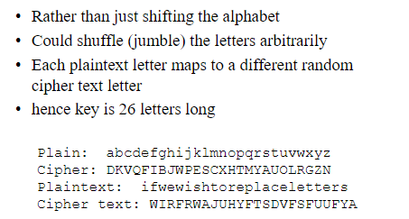
Substitution Cipher
Monoalphabetic Cipher

Slide 10
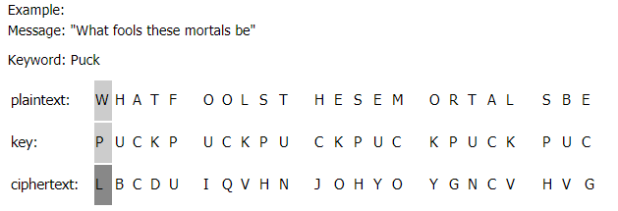
polyalphabetic substitution cipher
The Vigenère cipher is an example of a polyalphabetic substitution cipher. A polyalphabetic substitution cipher is similar to a monoalphabetic substitution except that the cipher alphabet is changed periodically while enciphering the message. This makes the cipher less vulnerable to cryptanalysis using letter frequencies.
Keyword Method
The keyword can be of any length greater than one, which provides an unlimited number of possible keys. To form the key, the sender writes the keyword repeatedly on the line underneath the plaintext. The plaintext-key pairs in each column will then be enciphered using the Vigenère square
Notes:
https://www.cs.uri.edu/cryptography/classicalvigenere.htm#:~:text=The%20Vigen%C3%A8re%20cipher%20is%20an,periodically%20while%20enciphering%20the%20message.&text=He%20used%20a%20table%20known,Vigen%C3%A8re%20square%2C%20to%20encipher%20messages.

Slide 11
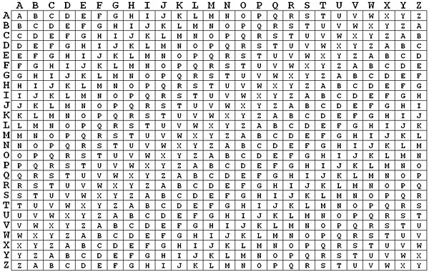
polyalphabetic substitution cipher

Slide 12
Ciphers
Shannon’s Characteristics of “Good” Ciphers
The amount of secrecy needed should determine the amount of labor appropriate for the encryption and decryption.
The set of keys and the enciphering algorithm should be free from complexity.
The implementation of the process should be as simple as possible.
Errors in ciphering should not propagate and cause corruption of further information in the message.
The size of the enciphered text should be no larger than the text of the original message.
Notes:
Statistical Analysis
Knowing % of occurrences of different letters (e.g. e occurs 13% of time in the document and t occurs 19% of times)
Knowing commonly occurring two and three letter combinations (e.g. in, it, the, ion, ing, …)
If some knowledge about the content is available it is even easier to crack

Slide 13
Encryption Systems
Properties of Trustworthy Systems
It is based on sound mathematics.
  Good cryptographic algorithms are are derived from solid principles.
It has been analyzed by competent experts and found to be sound.
  Since it is hard for the writer to envisage all possible attacks on the algorithm
It has stood the “test of time.”
  Over time people continue to review both mathematical foundations of an algorithm and the way it builds upon those foundations.
  The flaws in most algorithms are discovered soon after their release.
Notes:
Statistical Analysis
Knowing % of occurrences of different letters (e.g. e occurs 13% of time in the document and t occurs 19% of times)
Knowing commonly occurring two and three letter combinations (e.g. in, it, the, ion, ing, …)
If some knowledge about the content is available it is even easier to crack

Slide 14
Cryptanalysis
Techniques
Cryptanalysis is the process of breaking an encryption code
  Tedious and difficult process
Several techniques can be used to deduce the algorithm
  Attempt to recognize patterns in encrypted messages, to be able to break subsequent ones by applying a straightforward decryption algorithm
  Attempt to infer some meaning without even breaking the encryption, such as noticing an unusual frequency of communication or determining something by whether the communication was short or long
  Attempt to deduce the key, in order to break subsequent messages easily
  Attempt to find weaknesses in the implementation or environment of use of encryption
  Attempt to find general weaknesses in an encryption algorithm, without necessarily having intercepted any messages
Notes:
Statistical Analysis
Knowing % of occurrences of different letters (e.g. e occurs 13% of time in the document and t occurs 19% of times)
Knowing commonly occurring two and three letter combinations (e.g. in, it, the, ion, ing, …)
If some knowledge about the content is available it is even easier to crack

Slide 15
Data Encryption Standard (DES) Basics
Goal of DES is to completely scramble the data and key so that every bit of cipher text depends on every bit of data and ever bit of key
DES is a block Cipher Algorithm
  Encodes plaintext in 64 bit chunks
  One parity bit for each of the 8 bytes thus it reduces to 56 bits
It is the most used algorithm
  Standard approved by US National Bureau of Standards for Commercial and nonclassified US government use in 1993
Notes:
Statistical Analysis
Knowing % of occurrences of different letters (e.g. e occurs 13% of time in the document and t occurs 19% of times)
Knowing commonly occurring two and three letter combinations (e.g. in, it, the, ion, ing, …)
If some knowledge about the content is available it is even easier to crack

Slide 16
Data Encryption Standard (DES) Basics
64-bit input
56-bit key
48-bit k1
DES run in reverse to decrypt
Cracking DES
  1997: 140 days
  1999: 14 hours
TripleDES uses DES 3 times in tandem
  Output from 1 DES is input to next DES
L1
R1
F(L1, R1, K1)
48-bit k2
L2
R2
F(L2, R2, K2)
48-bit k3
L3
R3
F(L16, R16, K16)
48-bit k16
L17
R17
Notes:
DES consists of two permutations steps (the first and last steps of the algorithm)
Operation of each round is identical – taking output of the pervious round as input
During each round – the rightmost 32 bits of input are moved to left 32 bits of the output
The entire 64 bit input to the ith round and the 48-bit key for the ith round are taken as an input to a function
The function involves expansion of 4-bit chunks into 6-bit chunks , exclusive or-ing with the expanded 6-bit chunks of the 48-bit key Ki, a substitution operation and further exclusive OR-ing with the leftmost 32 bits of the input.
The resulting 32 bits of the input of the function is then used as the rightmost 32 bits of the round’s 64-bit output

Slide 17
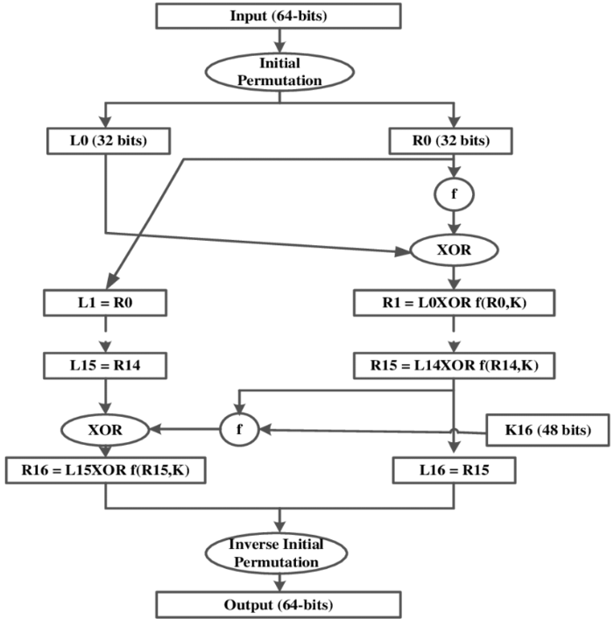

Slide 18
Data Encryption Standard (DES) Basics
64-bit input
56-bit key
48-bit k1
L1
R1
Operation of each round is identical – taking output of the pervious round as input
During each round – the rightmost 32 bits of input are moved to left 32 bits of the output
The function F involves expansion of 4-bit chunks into 6-bit chunks , exclusive or-ing with the expanded 6-bit chunks of the 48-bit key Ki, a substitution operation and further exclusive OR-ing with the leftmost 32 bits of the input.
The resulting 32 bits of the input of the function is then used as the rightmost 32 bits of the round’s 64-bit output
F(L1, R1, K1)
48-bit k2
L2
R2
F(L2, R2, K2)
48-bit k3
L3
R3
F(L16, R16, K16)
48-bit k16
L17
R17
Notes:
DES consists of two permutations steps (the first and last steps of the algorithm)
Operation of each round is identical – taking output of the pervious round as input
During each round – the rightmost 32 bits of input are moved to left 32 bits of the output
The entire 64 bit input to the ith round and the 48-bit key for the ith round are taken as an input to a function
The function involves expansion of 4-bit chunks into 6-bit chunks , exclusive or-ing with the expanded 6-bit chunks of the 48-bit key Ki, a substitution operation and further exclusive OR-ing with the leftmost 32 bits of the input.
The resulting 32 bits of the input of the function is then used as the rightmost 32 bits of the round’s 64-bit output

Slide 19
Key Structure
Initial Key Size: The original key for DES is 64 bits, but only 56 bits are used for encryption.
Key Parity Bits: The remaining 8 bits are parity bits, added for error detection. Each of these parity bits is set to ensure that the corresponding 7 bits have an odd number of 1s.
Key Scheduling in DES
Key Transformation: The 56-bit key undergoes a key scheduling process to produce subkeys for each round of encryption.
Subkey Generation:
  DES has 16 rounds of encryption.
  For each round, a 48-bit subkey is derived from the original 56-bit key.
  A 48-bit subkey is selected from the 56-bit key using a specific permutation.
Why 48 Bits?
The use of a 48-bit subkey allows the algorithm to perform bitwise operations (such as XOR) effectively, ensuring that each round of encryption has enough complexity and diffusion.
Security: The reduction to 48 bits helps balance security with efficiency. While 56 bits are already considered small by modern standards, the 48-bit subkeys increase the number of possible combinations in each round without significantly complicating the encryption process.

Slide 20
Encryption Algorithm
(Time to explore more by yourself)
Algorithm | Type | Key Size | Features
DES | Block Cipher | 56 bits | Most Common, Not strong enough
TripleDES | Block Cipher | 168 bits (112 effective) | Modification of DES, Adequate Security
Blowfish | Block Cipher | Variable (Up to 448 bits) | Excellent Security
AES | Block Cipher | Variable (128, 192, or 256 bits) | Replacement for DES, Excellent Security
RC4 | Stream Cipher | Variable (40 or 128 bits) | Fast Stream Cipher, Used in most SSL implementations
Notes:
Statistical Analysis
Knowing % of occurrences of different letters (e.g. e occurs 13% of time in the document and t occurs 19% of times)
Knowing commonly occurring two and three letter combinations (e.g. in, it, the, ion, ing, …)
If some knowledge about the content is available it is even easier to crack

Slide 21

Symmetric Encryption
Limitations
Any exposure to the secret key compromises secrecy of ciphertext
A key needs to be delivered to the recipient of the coded message for it to be deciphered
  Potential for eavesdropping attack during transmission of key
Notes:
1. Must have done this as an assignment last year.

Slide 22
Asymmetric Encryption
Basics
Uses a pair of keys for encryption
  Public key for encryption
  Private key for decryption
Messages encoded using public key can only be decoded by the private key
  Secret transmission of key for decryption is not required
  Every entity can generate a key pair and release its public key
Plain Text
Cipher
Cipher Text
Cipher
Plain Text
Public Key
Private Key
Notes:
1. Must have done this as an assignment last year.

Slide 23
Asymmetric Encryption
Types
Two most popular algorithms are RSA & El Gamal
  RSA (Rivest–Shamir–Adleman)
    Developed by Ron Rivest, Adi Shamir, Len Adelman
    Both public and private key are interchangable
    Variable Key Size (512, 1024, or 2048 bits)
    Most popular public key algorithm
  El Gamal
    Developed by Taher ElGamal
    Variable key size (512 or 1024 bits)
    Less common than RSA
Notes:
1. Must have done this as an assignment last year.

Slide 24
Asymmetric Encryption
RSA
Choose two large prime numbers p & q
Compute n=pq and z=(p-1)(q-1)
Choose number e, less than n, which has no common factor (other than 1) with z
Find number d, such that ed – 1 is exactly divisible by z
Keys are generated using n, d, e
  Public key is (n,e)
  Private key is (n, d)
Encryption: c = m^{e} mod n
  m is plain text
  c is cipher text
Decryption: m = c^{d} mod n
Public key is shared and the private key is hidden
Notes:
1. Must have done this as an assignment last year.

Slide 25
Asymmetric Encryption
RSA
P=5 & q=7
n=5*7=35 and z=(4)*(6) = 24
e = 5
d = 29 , (29x5 –1=144) (144/24=6) is exactly divisible by 24
Keys generated are
  Public key: (35,5), n=35
  Private key is (35, 29)
Encrypt the word love using (c = m^{e} mod n)
  Assume that the alphabets are between 1 & 26
Plain Text | Numeric Representation | m^{e} | Cipher Text (c = m^{e} mod n)
l | 12 | 248832 | 17
o | 15 | 759375 | 15
v | 22 | 5153632 | 22
e | 5 | 3125 | 10
Notes:
1. Must have done this as an assignment last year.

Slide 26
Asymmetric Encryption
RSA
Decrypt the word love using (m = c^{d} mod n)
  n = 35, c = cipher text, d = 29
Cipher Text | c^{d} | (m = c^{d} mod n) | Plain Text
17 | 481968572106750915091411825223072000 | 12 | l
15 | 12783403948858939111232757568359400 | 15 | o
22 | 852643319086537701956194499721110000000 | 22 | v
10 | 100000000000000000000000000000 | 5 | e
Notes:
1. Must have done this as an assignment last year.

Slide 27
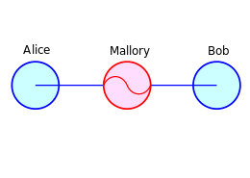
Asymmetric Encryption
Weaknesses
Efficiency is lower than Symmetric Algorithms
  A 1024-bit asymmetric key is equivalent to 128-bit symmetric key
Potential for man-in-the middle attack
It is problematic to get the key pair generated for the encryption
man-in-the middle attack: cyberattack where the attacker secretly relays and possibly alters the communications between two parties who believe that they are directly communicating with each other
Notes:
1. Must have done this as an assignment last year.

Slide 28
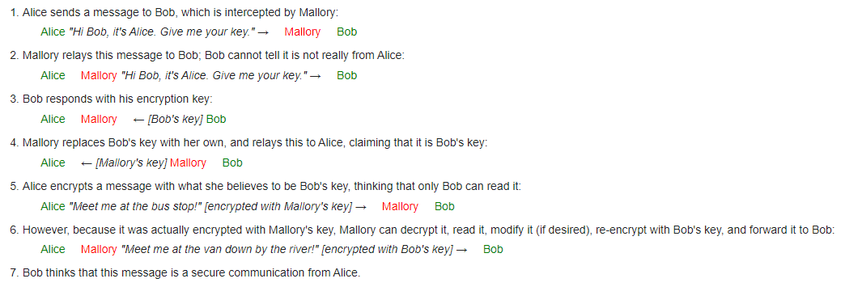
Asymmetric Encryption
Weaknesses

Slide 29

Asymmetric Encryption
Man-in-the-middle Attack
Hacker could generate a key pair, give the public key away and tell everybody, that it belongs to somebody else. Now, everyone believing it will use this key for encryption, resulting in the hacker being able to read the messages. If he encrypts the messages again with the public key of the real recipient, he will not be recognized easily.
Bob
Trudeau’s
Message
+ public key
Cipher
Trudeau’s
Encrypted
Message
David’s
Public Key
Bob’s
Message
+ Public key
Cipher
David’s
Public Key
Bob’s
Encrypted
Message
Trudeau
(Middle-man)
David
Bob’s
Public Key
Attacker
Trudeau’s
Public Key
Trudeau’s
Encrypted
Message
Cipher
Trudeau’s
New Message
+ public key
Trudeau’s
Encrypted
Message
Cipher
David’s
Message
+ public key
Notes:
1. Must have done this as an assignment last year.

Slide 30
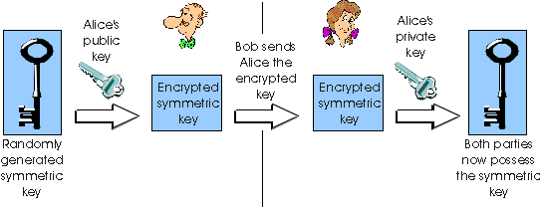
Asymmetric Encryption
Session-Key Encryption
Used to improve efficiency
  Symmetric key is used for encrypting data
  Asymmetric key is used for encrypting the symmetric key
  Many Internet commerce paradigms make use of session keys.
Notes:
1. Must have done this as an assignment last year.

Slide 31
Asymmetric Encryption
Encryption Protocols
Pretty Good Privacy (PGP)
  Used to encrypt e-mail using session key encryption
  Combines RSA, TripleDES, and other algorithms
Secure/Multipurpose Internet Mail Extension (S/MIME)
  Newer algorithm for securing e-mail
  Backed by Microsoft, RSA, AOL
Secure Socket Layer(SSL) and Transport Layer Socket(TLS)
  Used for securing TCP/IP Traffic
  Mainly designed for web use
  Can be used for any kind of internet traffic
Notes:
1. Must have done this as an assignment last year.

Slide 32
Asymmetric Encryption
Key Agreement
Key agreement is a method to create secret key by exchanging only public keys.
Example
  Bob sends Alice his public key
  Alice sends Bob her public key
  Bob uses Alice’s public key and his private key to generate a session key
  Alice uses Bob’s public key and her private key to generate a session key
  Using a key agreement algorithm both will generate same key
  Bob and Alice do not need to transfer any key
Alice’s
Private Key
Cipher
(DES)
Bob’s
Public Key
Alice and Bob
Generate Same
Session Key!
Bob’s
Private Key
Session Key
Cipher
(DES)
Alice’s
Public Key
Notes:
1. Must have done this as an assignment last year.

Slide 33
Asymmetric Encryption
Key Diffie-Hellman Mathematical Analysis
Bob & Alice
agree on non-secret
prime p and value a
Bob
Alice
Generate Secret
Random Number x
Generate Secret
Random Number y
Compute Public Key
a^{x} mod p
Bob & Alice exchange public keys
Compute Public Key
a^{y} mod p
Compute Session Key
(a^{y})^{x} mod p
Compute Session Key
(a^{x})^{y} mod p
Identical Secret Key

Slide 34
Asymmetric Encryption
Key Agreement con’t.
Diffie-Hellman is the first key agreement algorithm
  Invented by Whitfield Diffie & Martin Hellman
  Provided ability for messages to be exchanged securely without having to have shared some secret information previously
No exchange of secret keys
  Man-in-the middle attack avoided
Notes:
1. Must have done this as an assignment last year.

Slide 35
Authentication
Basics
Authentication is the process of validating the identity of a user or the integrity of a piece of data.
There are three technologies that provide authentication
  Message Digests / Message Authentication Codes
  Digital Signatures
  Public Key Infrastructure
There are two types of user authentication:
  Identity presented by a remote or application participating in a session
  Sender’s identity is presented along with a message.
Notes:
Page 120-131, Secure Electronic Commerce

Slide 36
Authentication
Message Digests
A message digest is a fingerprint for a document
Purpose of the message digest is to provide proof that data has not altered
Process of generating a message digest from data is called hashing
Hash functions are one way functions with following properties
  Infeasible to reverse the function
  Infeasible to construct two messages which hash the same digest
Commonly used hash algorithms are
  MD5 – 128 bit hashing algorithm
  SHA & SHA-1 – 162 bit hashing algorithm
Message
Message
Digest
Algorithm
Digest
Notes:
1. Must have done this as an assignment last year.

Slide 37
Message Authentication Codes
Basics
A message digest created with a key
Creates security by requiring a secret key to be possessed by both parties in order to retrieve the message
Message
Message
Digest
Algorithm
Digest
Secret Key
Notes:
1. Must have done this as an assignment last year.

Slide 38
Password Authentication
Basics
Password is secret character string only known to user and server
Message Digests commonly used for password authentication
Stored hash of the password is a lesser risk
  Hacker can not reverse the hash except by brute force attack
Problems with password based authentication
  Attacker learns password by social engineering
  Attacker cracks password by brute-force and/or guesswork
  Eavesdrops password if it is communicated unprotected over the network
  Replays an encrypted password back to the authentication server
Notes:
1. Must have done this as an assignment last year.

Slide 39
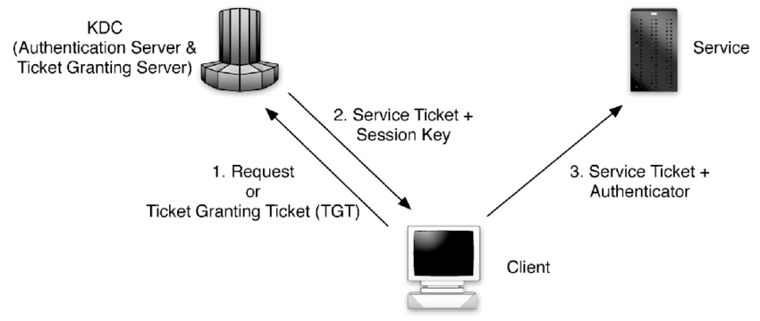
Authentication Protocols
Kerberos
Kerberos is an authentication service that uses symmetric key encryption and a key distribution center.
Kerberos Authentication server contains symmetric keys of all users and also contains information on which user has access privilege to which services on the network
Notes:
1. Must have done this as an assignment last year.

Slide 40
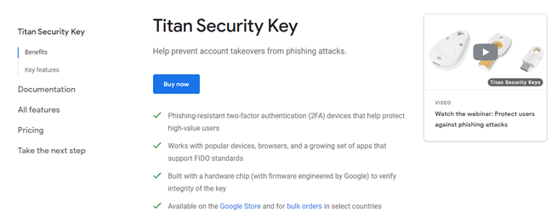
Authentication
Personal Tokens
Personal Tokens are hardware devices that generate unique strings that are usually used in conjunction with passwords for authentication
A variety of different physical forms of tokens exist
  e.g. hand-held devices, Smart Cards, PCMCIA cards, USB tokens
Notes:
1. Must have done this as an assignment last year.

Slide 41
Authentication
Biometrics
Uses certain biological characteristics for authentication
  Biometric reader measures physiological indicia and compares them to specified values
  It is not capable of securing information over the network
Different techniques exist
  Fingerprint Recognition
  Voice Recognition
  Handwriting Recognition
  Face Recognition
  Retinal Scan
  Hand Geometry Recognition
Notes:
1. Must have done this as an assignment last year.

Slide 42
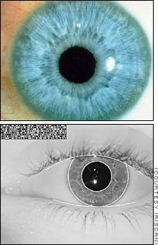
Authentication
Iris Recognition
The scanning process takes advantage of the natural patterns in people's irises, digitizing them for identification purposes
Facts
Probability of two irises producing exactly the same code: 1 in 10 to the 78th power
Independent variables (degrees of freedom) extracted: 266
IrisCode record size: 512 bytes
Operating systems compatibility: DOS and Windows (NT/95)
Average identification speed (database of 100,000 IrisCode records): one to two seconds
Notes:
1. Must have done this as an assignment last year.

Slide 43
Authentication
Digital Signatures
A digital signature is a data item which accompanies or is logically associated with a digitally encoded message.
It has two goals
  A guarantee of the source of the data
  Proof that the data has not been tampered with
Sender’s
Private Key
Sender’s
Public Key
Message
Sent to
Receiver
Digest
Algorithm
Digest
Algorithm
Message
Digest
Same?
Message
Digest
Signature
Algorithm
Digital
Signature
Sent to
Receiver
Signature
Algorithm
Message
Digest
Sender
Receiver
Notes:
To create a digital signature, the user simple creates a message digest of the document to be signed and then encrypts it with their private key.

Slide 44
Authentication
Digital Certificates
A digital certificate is a signed statement by a trusted party that another party’s public key belongs to them.
Verisign is industry standard certificate authority
Identity
Information
Signature
Algorithm
Certificate
Sender’s
Public Key
Certificate Authority’s Private Key
Notes:
1. Must have done this as an assignment last year.

Slide 45
Cryptanalysis
Basics
Practice of analyzing and breaking cryptography
Resistance to crypt analysis is directly proportional to the key size
  With each extra byte strength of key doubles
Variety of methods for safe guarding keys (Key Management)
  Encryption & computer access protection
  Smart Cards
Notes:
A web browser has a digital certificate from verisign which is the root certification authority.

